Slide 1
APPLIED PHSICS
(SEAP-113)

Slide 2
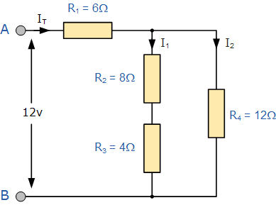
Series and Parallel Resistor Combination
A little complex example

Slide 3
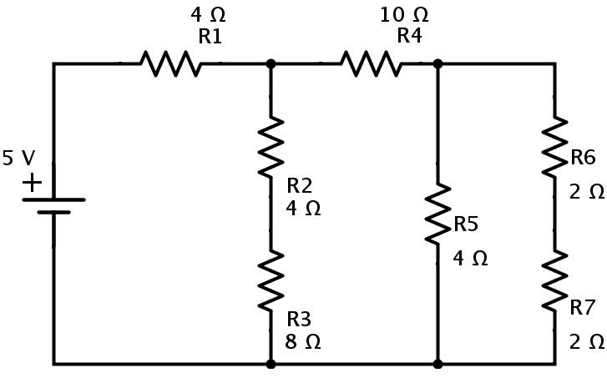
Series and Parallel Resistor Combination
Task for you

Slide 4
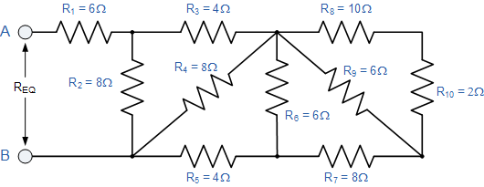
Series and Parallel Resistor Combination
A complex example

Slide 5
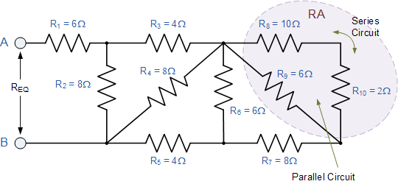
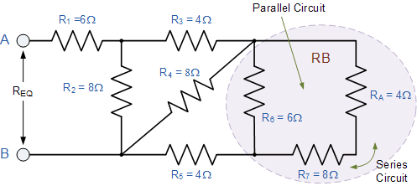
Series and Parallel Resistor Combination
A complex example

Slide 6
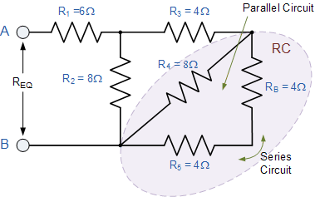
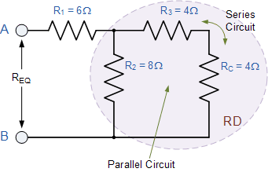
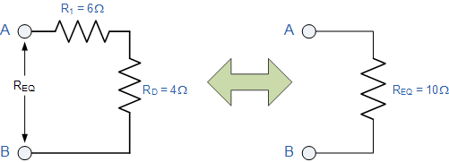
Series and Parallel Resistor Combination
A complex example

Slide 7
Kirchhoff’s Laws

Slide 8

Kirchhoff’s Current Law (KCL)
Kirchhoff’s Current Law is one of the fundamental law used for circuit analysis
It states that the total current entering a circuits node is exactly equal to the total current leaving the same node
Mathematically we can write it as
$$\sum{I_{IN}=\sum{I_{OUT}}}$$

Slide 9
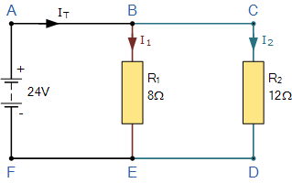
Kirchhoff’s Current Law (KCL) contd.
lets take a simple example

Slide 10
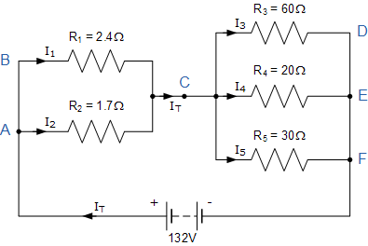
Kirchhoff’s Current Law (KCL) contd.
lets take a complex example

Slide 11
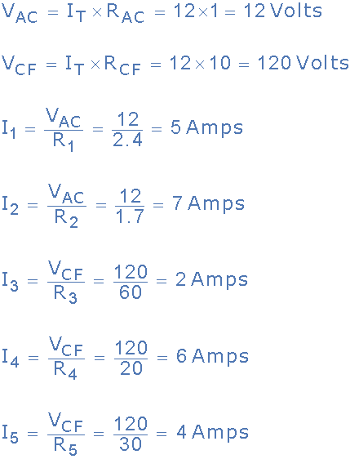
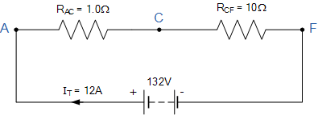
Kirchhoff’s Current Law (KCL) contd.
Equivalent circuit will be

Slide 12
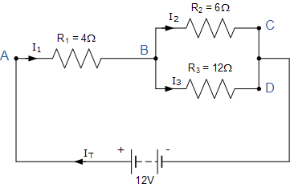
Kirchhoff’s Current Law (KCL) contd.
Lets take another simple example

Slide 13

Kirchhoff’s Voltage Law (KVL)
Kirchhoff’s Voltage Law is the second of his fundamental laws we can use for circuit analysis
It states that for a closed loop series path the algebraic sum of all the voltages around any closed loop in a circuit is equal to zero
Mathematically we can write it as
$$\sum{V}=0 for a closed loop$$

Slide 14
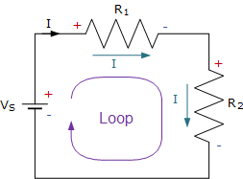
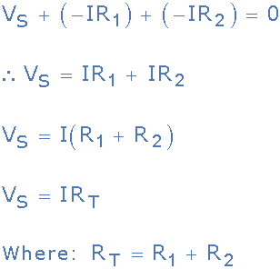
Kirchhoff’s Voltage Law (KVL) contd.

Slide 15
Kirchhoff’s Voltage Law (KVL) contd.
Three resistor of values: 10 ohms, 20 ohms and 30 ohms, respectively are connected in series across a 12 volt battery supply. Calculate: a) the total resistance, b) the circuit current, c) the current through each resistor, d) the voltage drop across each resistor e) verify that Kirchhoff’s voltage law, KVL holds true.

Slide 16
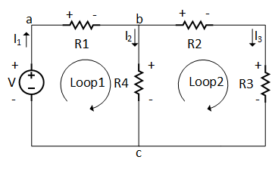
Kirchhoff’s Voltage Law (KVL) contd.
Another example with two loops where we have values of resistors and voltage source as follows:
R₁=5Ω, R₂=10Ω, R₃=5Ω and R₄=10Ω and V=20V

Slide 17

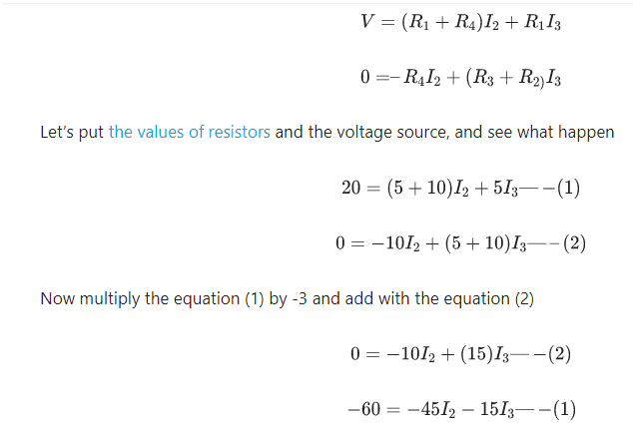
Kirchhoff’s Voltage Law (KVL) contd.

Slide 18
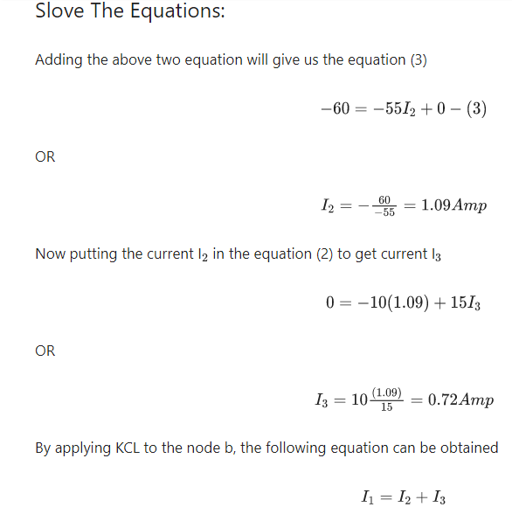
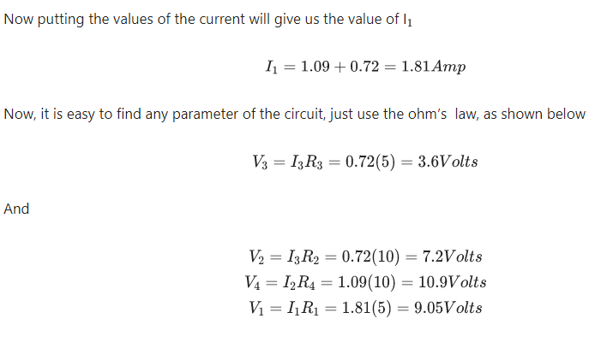
Kirchhoff’s Voltage Law (KVL) contd.

Slide 19
Introduction of Materials

Slide 20
Introduction of Materials
Every material in nature has certain properties. These properties define the behavior of the materials. Material Science is a branch of electronics that deals with the study of flow of electrons in various materials or spaces, when they are subjected to various conditions.
Due to the intermixing of atoms in solids, instead of single energy levels, there will be bands of energy levels formed. These set of energy levels, which are closely packed are called as Energy bands.

Slide 21
Types of Materials
The energy band in which valence electrons are present is called Valence band, while the band in which conduction electrons are present is called Conduction band. The energy gap between these two bands is called as Forbidden energy gap.
Electronically, the materials are broadly classified as Insulators, Semiconductors, and Conductors.

Slide 22
Types of Materials Contd.
Insulators − Insulators are such materials in which the conduction cannot take place, due to the large forbidden gap. Examples: Wood, Rubber.
Semiconductors − Semiconductors are such materials in which the forbidden energy gap is small and the conduction takes place if some external energy is applied. Examples: Silicon, Germanium.
Conductors − Conductors are such materials in which the forbidden energy gap disappears as the valence band and conduction band become very close that they overlap. Examples: Copper, Aluminum.

Slide 23
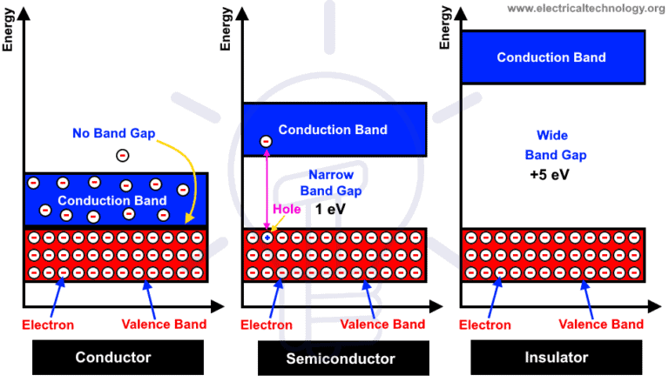

Slide 24
Why Semiconductor?
Of all the three, insulators are used where resistivity to electricity is desired and conductors are used where the conduction has to be high.
The semiconductors are the ones which give rise to a specific interest of how they are used.
We need to have strong control over the conductivity of material.
By controlling conductivity we can actually turn on and turn off the device which is very much required in digital circuits.
Semiconductors are employed in the manufacture of various kinds of electronic devices, including diodes, transistors, and integrated circuits.
Such devices have found wide application because of their compactness, reliability, power efficiency, and low cost.
Due to their role in the fabrication of electronic devices, semiconductors are an important part of our lives. Imagine life without electronic devices. There would be no smartphones, radios, TVs, computers, video games, or advanced medical diagnostic equipment.

